Slide 1
Deep Dive of the SharePoint Framework
SPFx Utilities

Slide 2
Agenda
Overview
Libraries / Methods
Q&A

Slide 3
SPFx Utilities
SPFx includes many utility libraries that make developing SPFx components easier for developers
To use the utilities
Import the appropriate utility library (if necessary)
Call methods in the libraries

Slide 4
Status Renderers
Use when a web part is loading information from SharePoint or to display errors if a web part runs into issues that could prevent it from working properly
Available via the web part context property
Use the entire web part UX
Loading indicators
Useful when you are initializing or loading any content in your web part.
Error indicators
Used to display error messages.

Slide 5
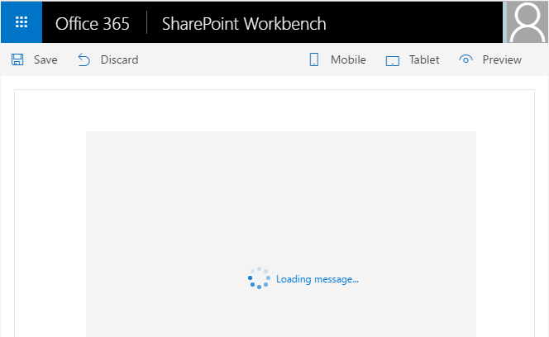
Loading Indicator
To display the loading indicator, call displayLoadingIndicator
this.context.statusRenderer.displayLoadingIndicator(this.domElement, "message");
To clear the loading indicator, call clearLoadingIndicator
this.context.statusRenderer.clearLoadingIndicator(this.domElement);

Slide 6
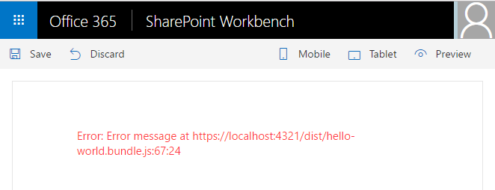
Error Indicator
To show an error, call renderError
this.context.statusRenderer.renderError(this.domElement, err);
To clear an error, call clearError
this.context.statusRenderer.clearError(this.domElement);

Slide 7
Lodash Utility Library
Use to perform operations on various objects like arrays, numbers, strings etc.
SharePoint Framework includes a subset of the lodash utility library
https://www.npmjs.com/package/@microsoft/sp-lodash-subset
import { escape, findIndex } from '@microsoft/sp-lodash-subset';
const index : number = findIndex(
this._spItems,
(item: ISPItem) => item.Title === 'Mock Title 3');
Notes:
Lodash is a great JavaScript utility library that you can use to perform operations on various objects like arrays, numbers, strings etc., SharePoint Framework includes the lodash utility library for use with SharePoint Framework out-of-the-box so you do not need to install it separately. To improve run-time performance, it only includes a subset of the most essential lodash functions.

Slide 8
Page Display Modes
Classic Pages
Page and web part can be in different modes
Modern Pages
Page and web part are always in the same mode
import { DisplayMode } from '@microsoft/sp-core-library';
const pageMode : string = this.displayMode === DisplayMode.Edit ? 'You are in edit mode' : 'You are in read mode';
<p class="ms-font-l ms-fontColor-white">${pageMode}</p>
Notes:
SharePoint pages have display modes which indicate in which mode that page and/or its contents (e.g. text and web parts) are displayed. In the classic server-side SharePoint page, the web page and the web part can be in different modes. For example, the web page can be in edit mode while the web part is not in edit mode. In the modern client-side SharePoint page, both the page and/or its contents are in the same mode.

Slide 9
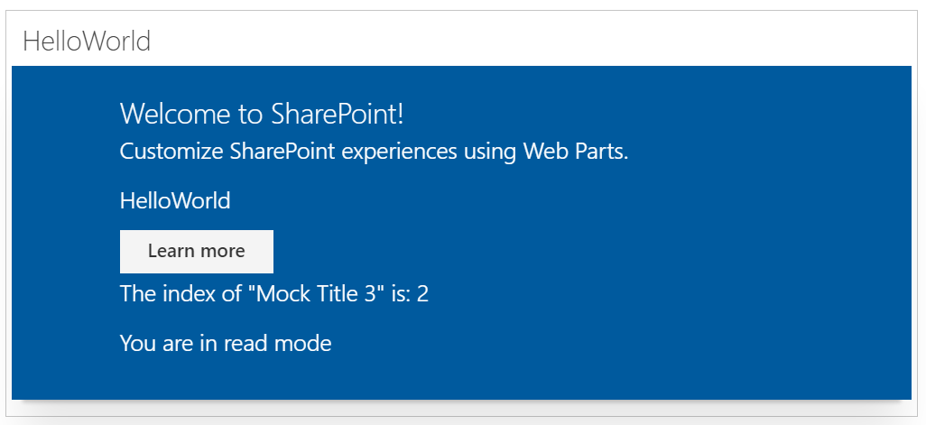
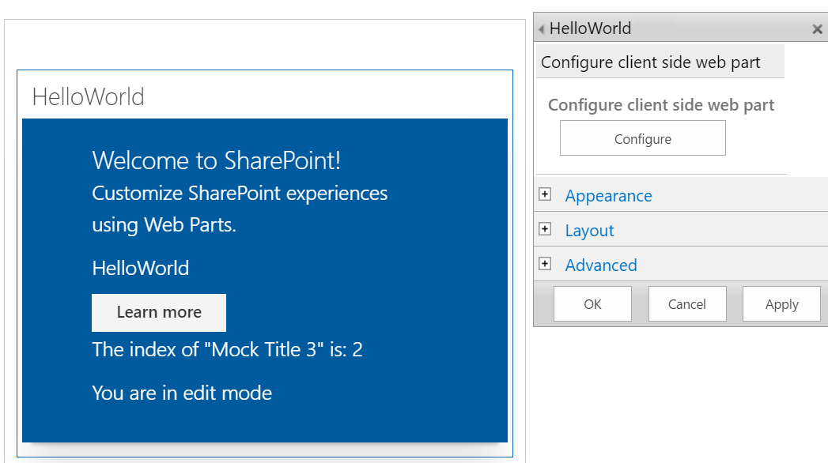
Page Display Modes – Classic Page
Page is not in Edit mode
Page is in Edit mode and the web part is in Edit mode
Page is in Edit mode and the web part is not in Edit mode

Slide 10
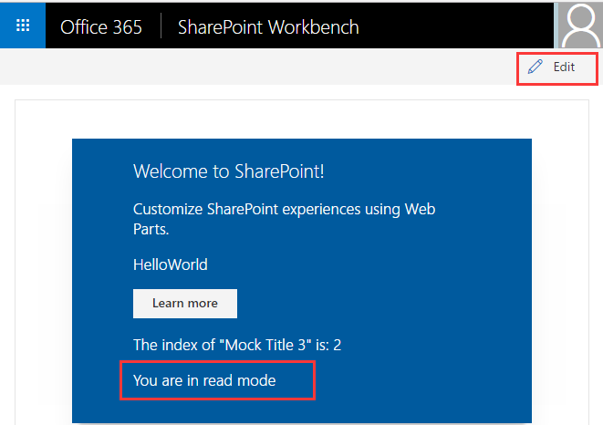
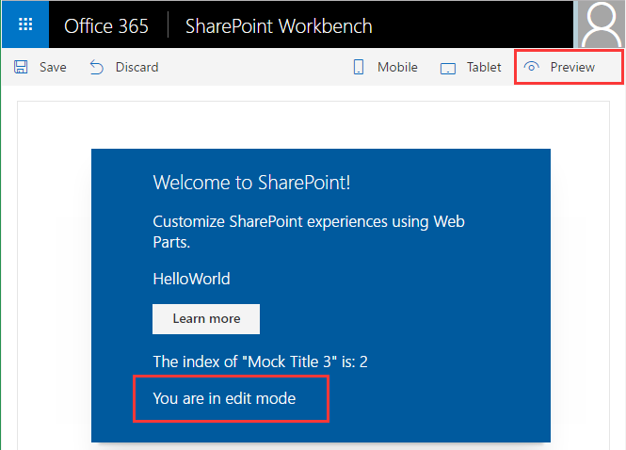
Page Display Modes – Modern Page

Slide 11
Page Context
Not available in local Workbench
Available in SharePoint Workbench
Accessible Properties
Web title
Web absolute URL
Web server-relative URL
User login name
<p class='ms-font-l ms-fontColor-white'>
Loading from ${this.context.pageContext.web.title}
</p>
Notes:
When the SharePoint workbench is hosted locally, you do not have the SharePoint page context. However, you can still test your web part in many different ways. For example, you can build the web part's UX and use mock data to simulate SharePoint interaction when you don't have the SharePoint context. However, when the workbench is hosted in SharePoint, you get access to the page context which provides various key properties, such as: - Web title - Web absolute URL - Web server-relative URL - User login name

Slide 12
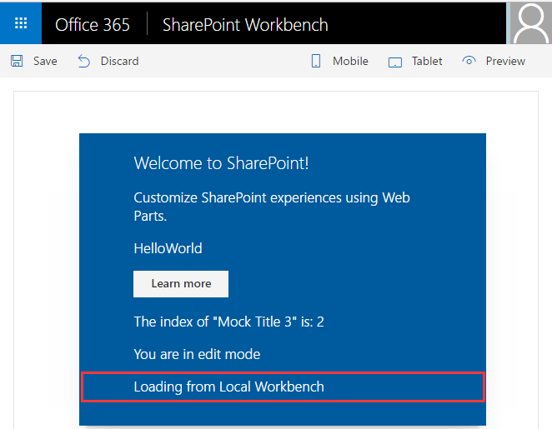
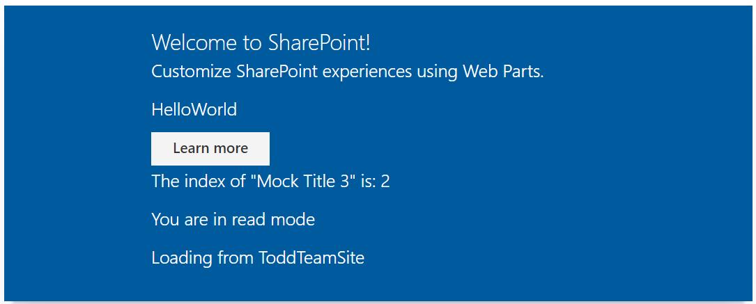
Page Context
web part running in the local Workbench
web part in the SharePoint Workbench, a modern, or a classic page

Slide 13
Environment Type
Use to determine where a web part is runnin
import { EnvironmentType } from '@microsoft/sp-core-library';
const environmentType : string = EnvironmentType.Local ? 'You are in local environment' : 'You are in sharepoint environment';
<p class="ms-font-l ms-fontColor-white">${environmentType}</p>
Notes:
The SharePoint workbench gives you the flexibility to test web parts in your local environment and from a SharePoint site. The EnvironmentType module is used to determine which environment your web part is running in.

Slide 14
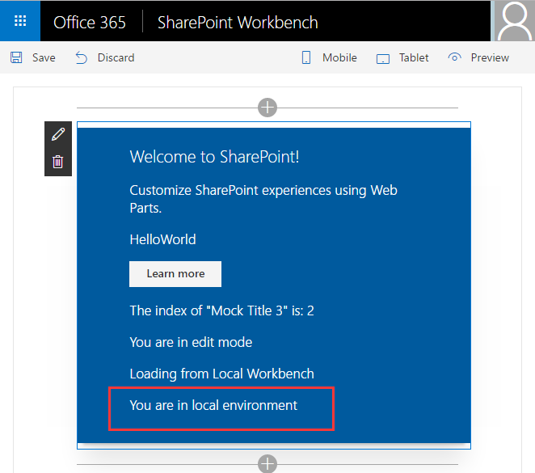
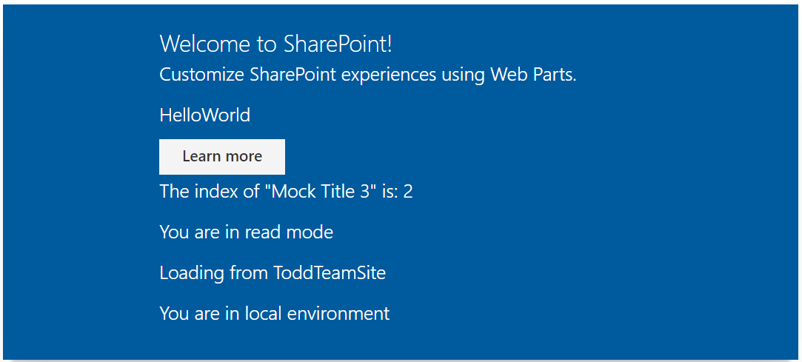
Environment Type
web part running in the local Workbench
web part running locally, but added to the SharePoint Workbench in an Office 365 developer
Notes:
The SharePoint workbench gives you the flexibility to test web parts in your local environment and from a SharePoint site. The EnvironmentType module is used to determine which environment your web part is running in.

Slide 15
Logging
SPFx includes a built-in logging mechanism
All logging is output to the JavaScript console
Four static logging methods available
info : log information
warn : log warnings
error : log errors
verbose : log everything
The logging methods share the same signature
source: the source of the logging information (max 20 characters), such as the method or the class name
message: the actual message to log (max 100 characters)
scope: an optional service scope
The error method takes an Error object instead of a message string
Notes:
Logging is a very convenient and easy way to keep track of events happening in the web part, instead of having breakpoints, or alerts in JavaScript. The SharePoint Framework has a built-in logging mechanism.
Note: The Log class contains four static methods for logging:
info : log information
warn : log warnings
error : log errors
verbose : log everything
In the SharePoint Framework all logging is done to the JavaScript console and you can see the logging using the developer tools in a web browser.
All static methods have the same signature, except the error method - they take three arguments:
source: the source of the logging information (max 20 characters), such as the method or the class name
message: the actual message to log (max 100 characters)
scope: an optional service scope
The error method takes an Error object instead of the message string, otherwise they are the same.

Slide 16
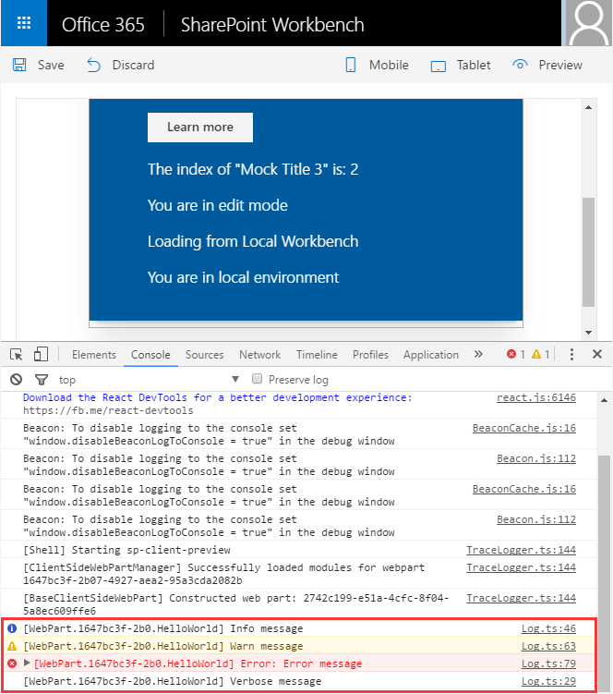
Logging
import { Log } from '@microsoft/sp-client-base';
Log.info('HelloWorld', 'Info message',
this.context.serviceScope);
Log.warn('HelloWorld', 'Warn message',
this.context.serviceScope);
Log.error('HelloWorld', new Error('Error message'),
this.context.serviceScope);
Log.verbose('HelloWorld', 'Verbose message',
this.context.serviceScope);
Notes:
Logging is a very convenient and easy way to keep track of events happening in the web part, instead of having breakpoints, or alerts in JavaScript. The SharePoint Framework has a built-in logging mechanism.
Note: The Log class contains four static methods for logging:
info : log information
warn : log warnings
error : log errors
verbose : log everything
In the SharePoint Framework all logging is done to the JavaScript console and you can see the logging using the developer tools in a web browser.
All static methods have the same signature, except the error method - they take three arguments:
source: the source of the logging information (max 20 characters), such as the method or the class name
message: the actual message to log (max 100 characters)
scope: an optional service scope
The error method takes an Error object instead of the message string, otherwise they are the same.

Slide 17
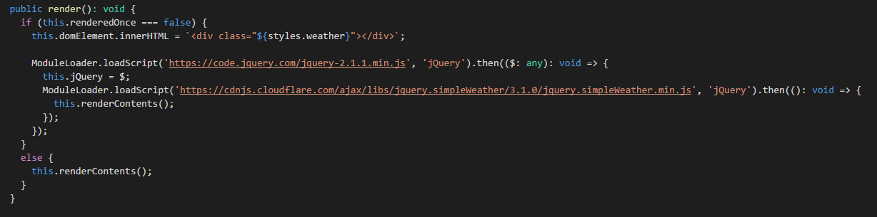
Loading scripts using ModuleLoader
Things to notice
Importing @Microsoft/sp-module-loader
Usage of this.renderedOnce
Usage of ModuleLoader

Slide 18
DEMO
SPFx Utilities
Notes:
Use the SPFx Utilities exercise in the lab manual.

Slide 19
Summary
Overview
Libraries / Methods
Q&A

Slide 20

Sharing is caring…
Code samples and solutions
Reusable components
Guidance documentation
Monthly community calls
SharePoint Framework
SharePoint add-ins
Microsoft Graph
Office 365 APIs
http://aka.ms/SharePointPnP

Slide 21

Q&A

Slide 22


